Slide 1

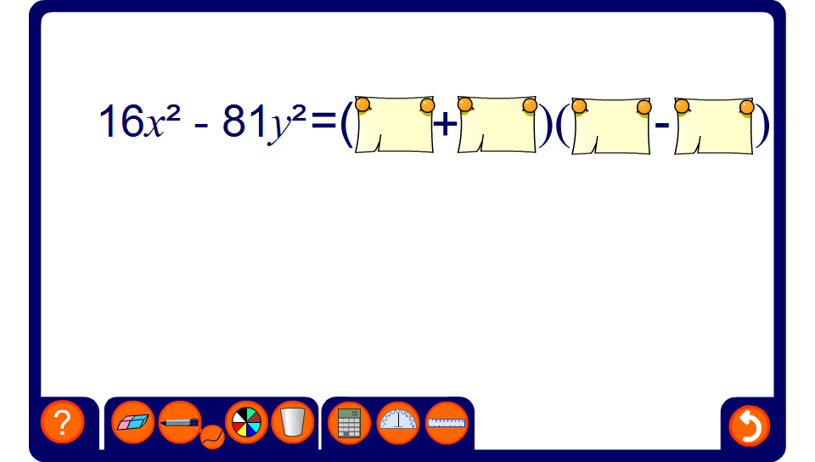


Factorising the difference between two squares

